Slide 1
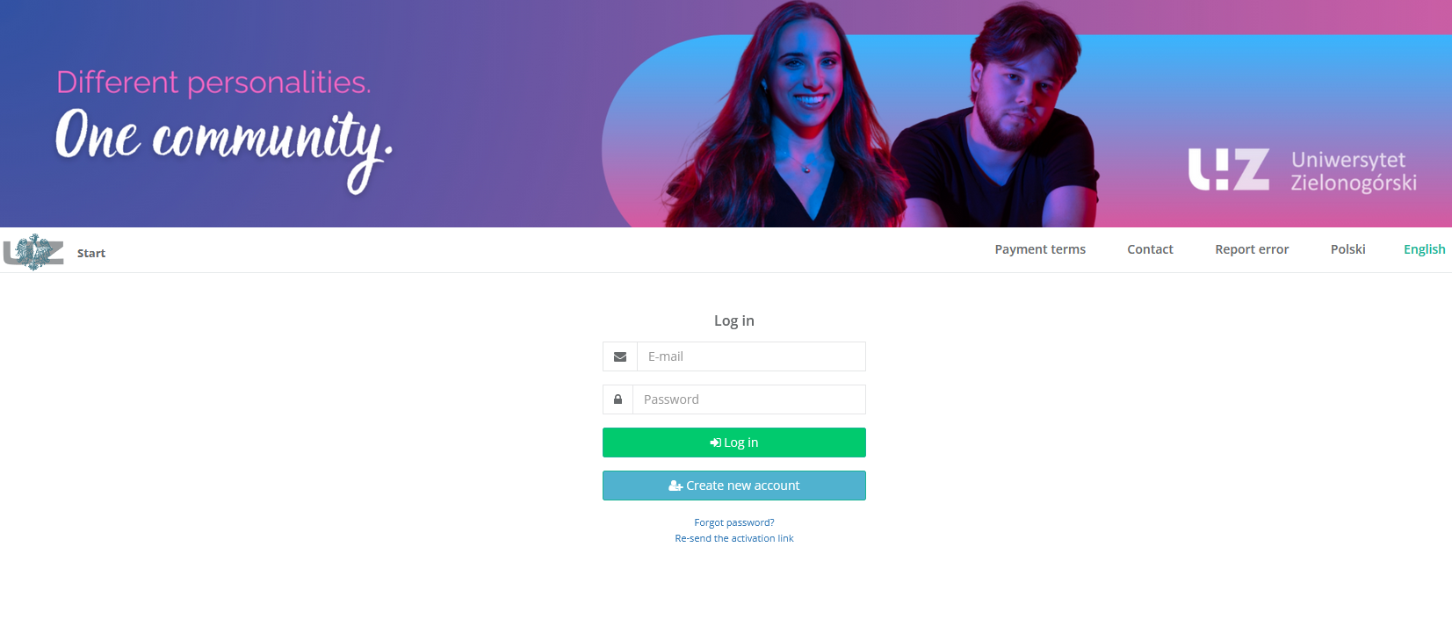

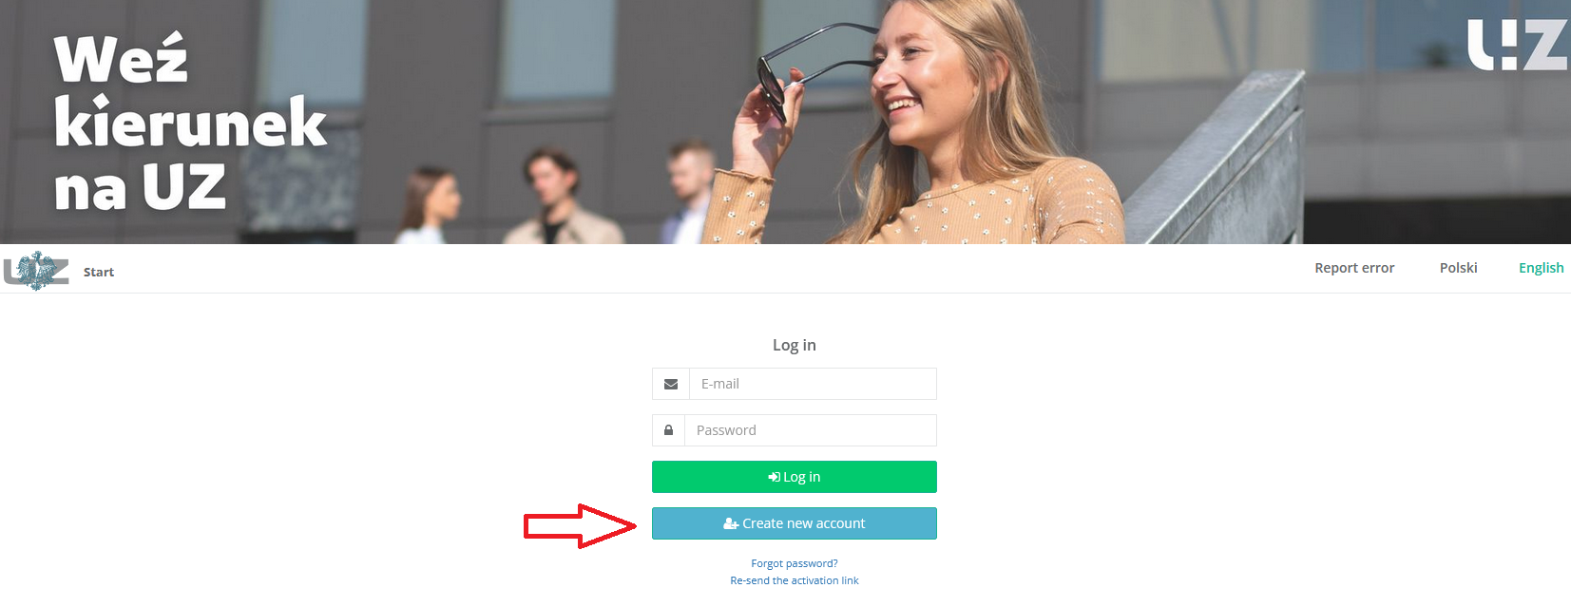

This is how the main page of recrutation system presents.
If you don’t have your account yet, please click „Create new account”:

Slide 2
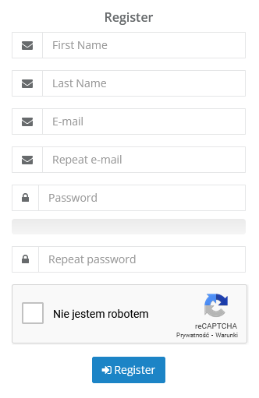
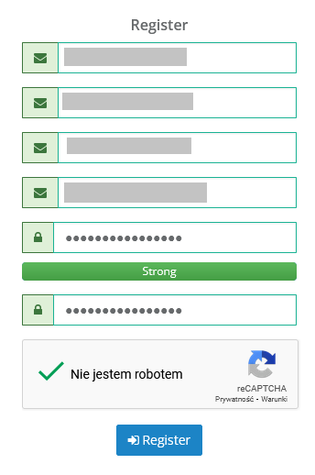
Fill up every required fields and create your password, then click „Register”:

Slide 3
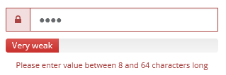
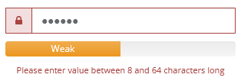



Don’t forget to create strong password!

Slide 4
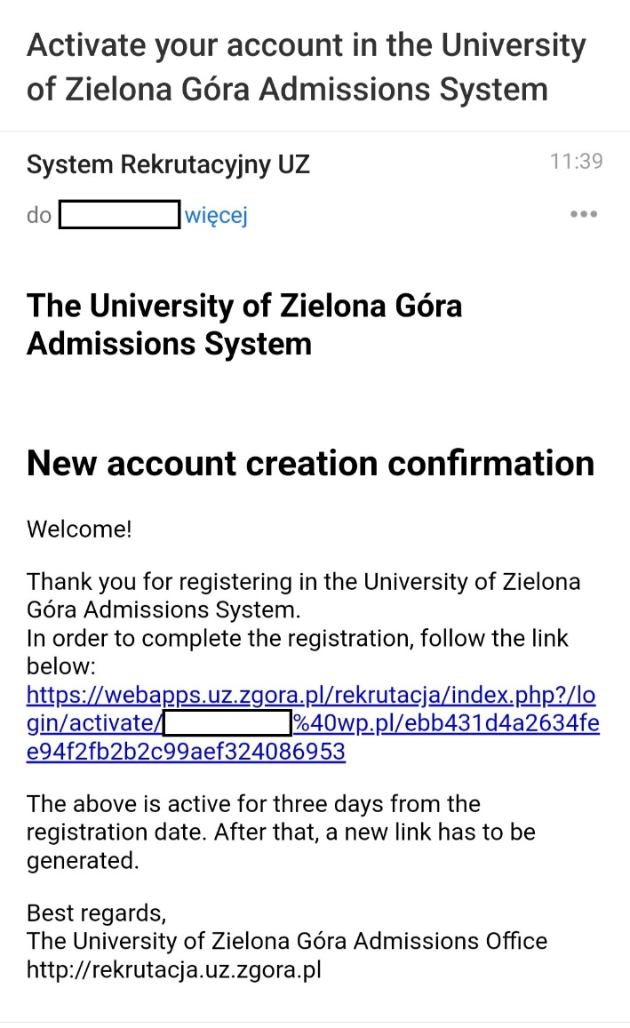
After registration check out your email:
Activation link will show up
on email that you indicated before.

Slide 5


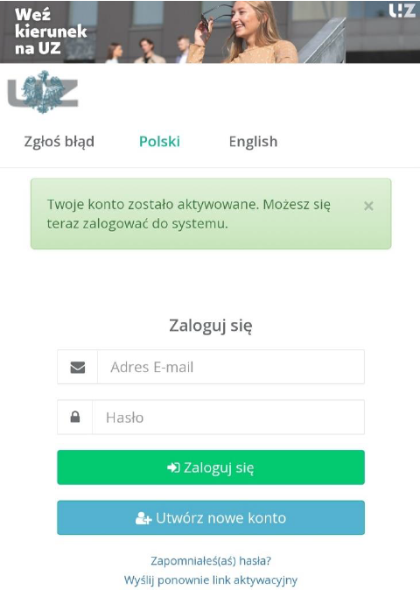

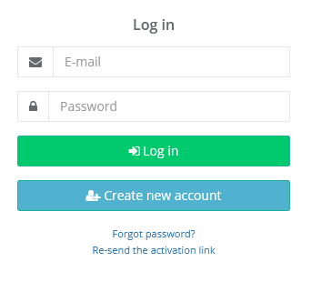
Done! You can log in now into the recruitment system and follow the instructions.

Slide 6
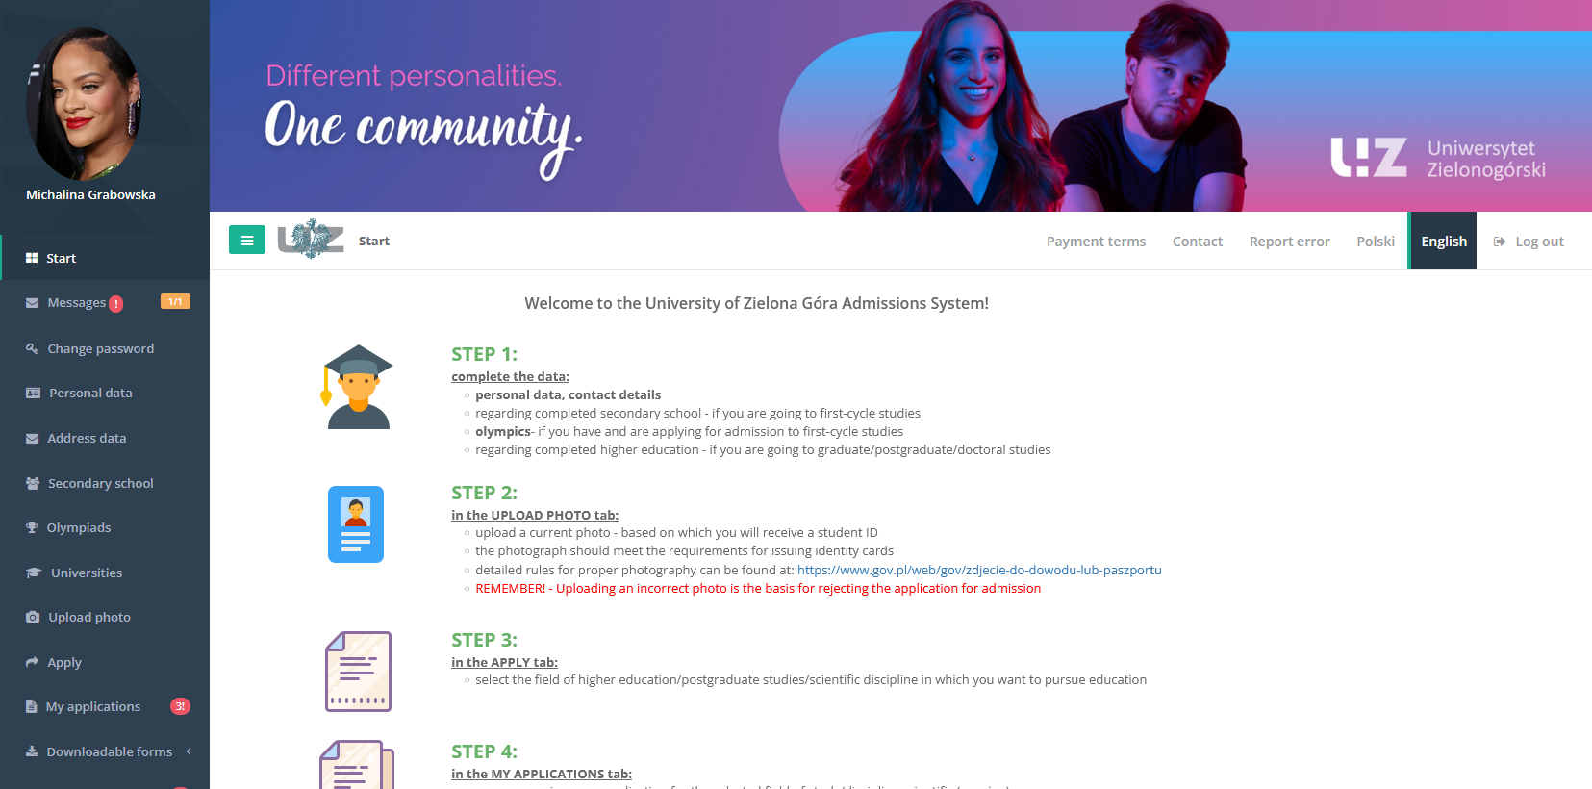
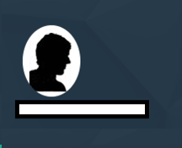
This is how your profile presents:
Now let's move to discussing the individual tabs so you won’t miss anything.

Slide 7
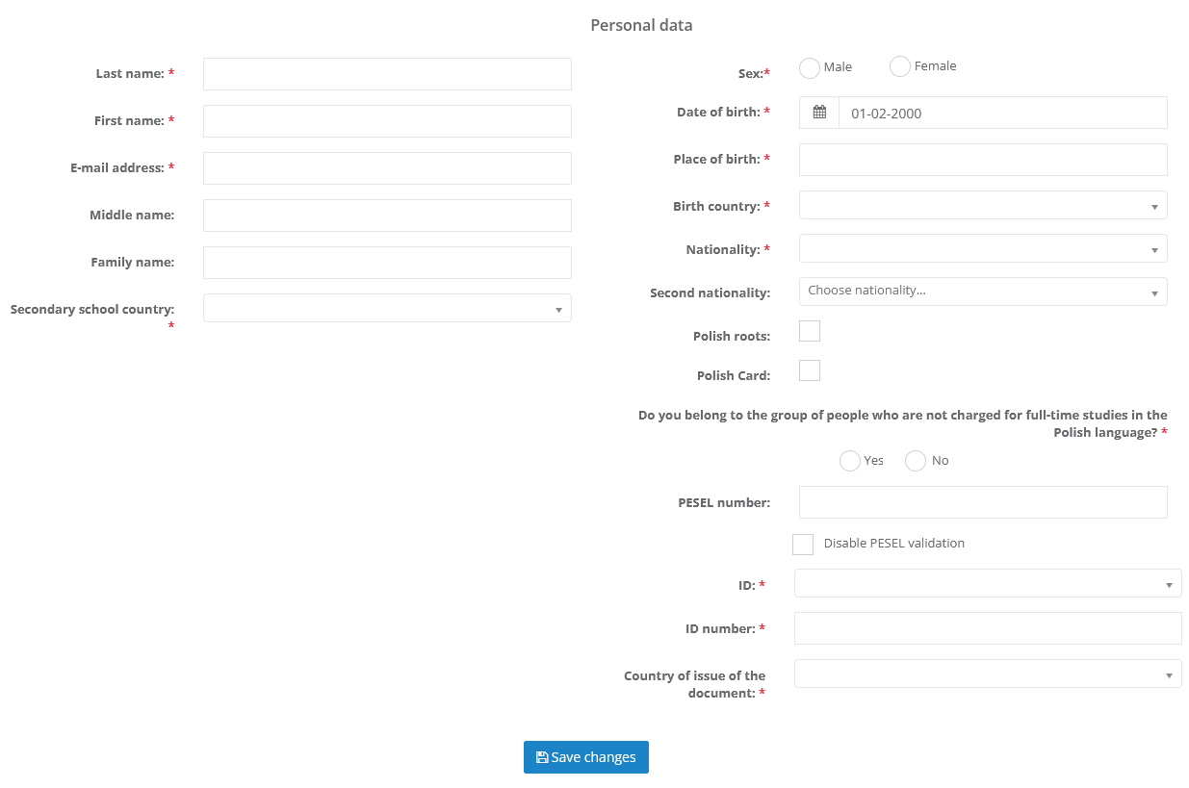
In „Personal data” you have to fill all required fields:

Slide 8
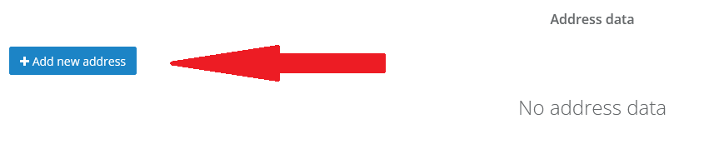
In „Address data” click a blue botton on the left side. Now you can upload your mailling address and your residence address.

Slide 9
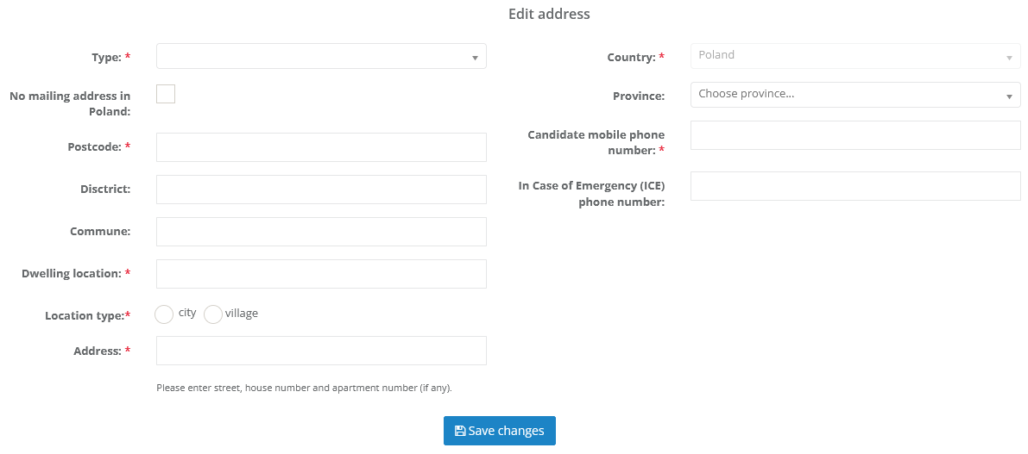
Fill up again all required fields like before and „Save changes”:

Slide 10
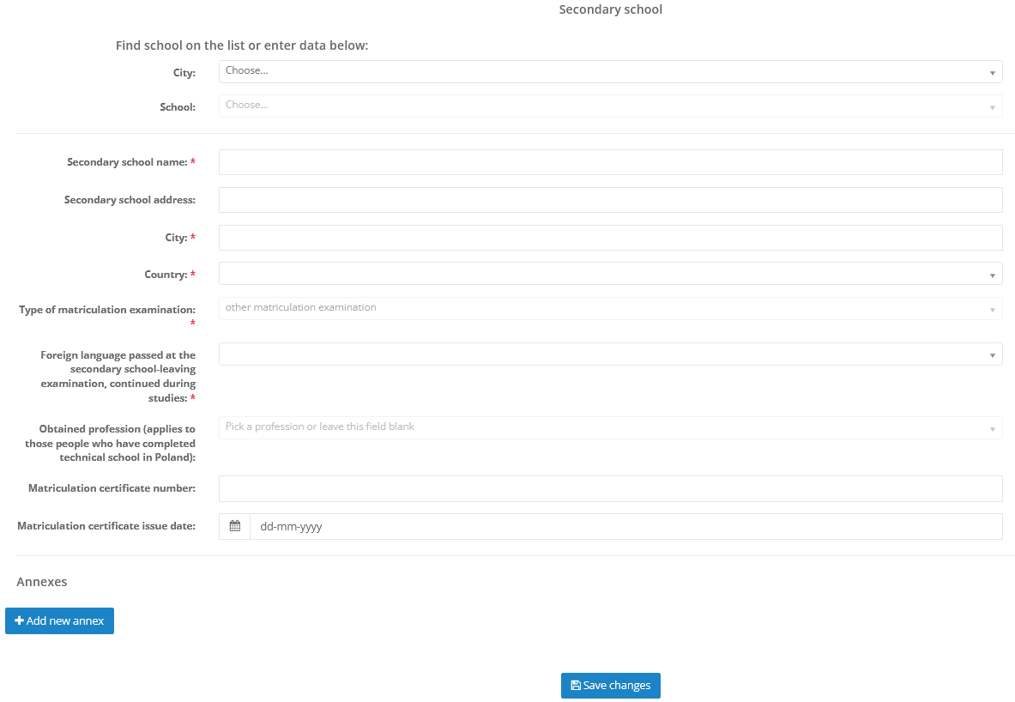
Next step is adding information about your secondary school. It doesn’t matter if you are taking part in recrutation for first-cycle degree or second-cycle degree studies. You have to fill up this fields in both cases. Please pay attention to the type of matriculation examination.

Slide 11
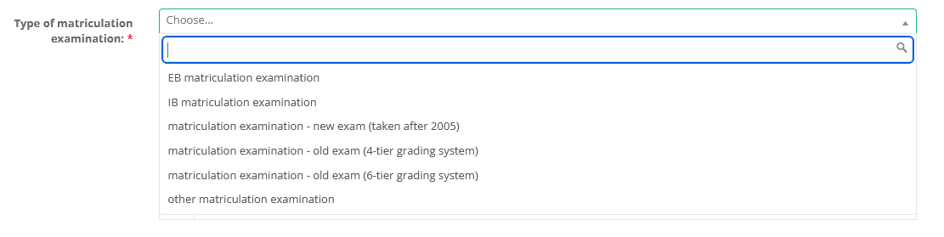
Please pay attention to the type of matriculation examination:

Slide 12
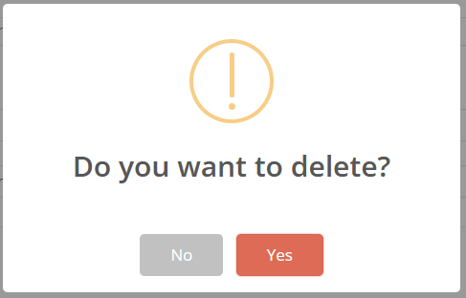
Got an error while adding data? You can easily fix it by clicking „Delete”:

Slide 13
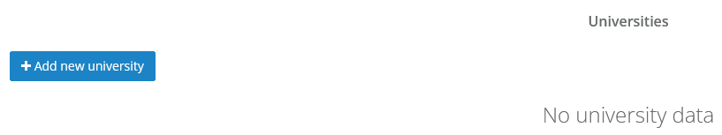
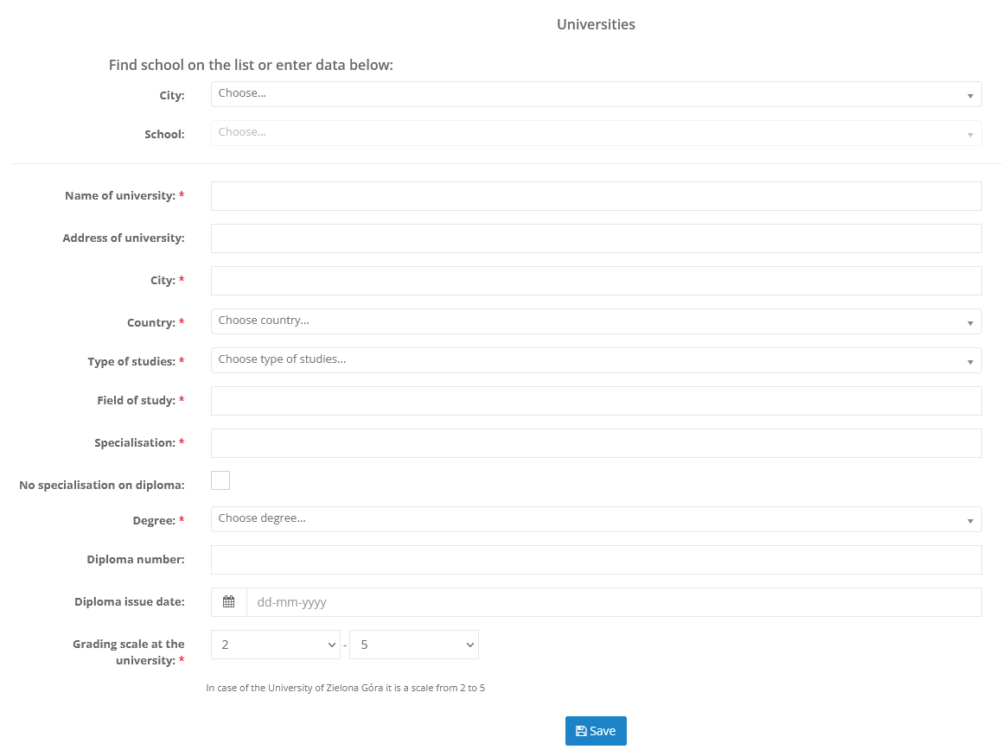
Do you taking part in recrutation for second-cycle degree studies? Here you can fill up all information about your first-cycle degree studies (previous university):

Slide 14
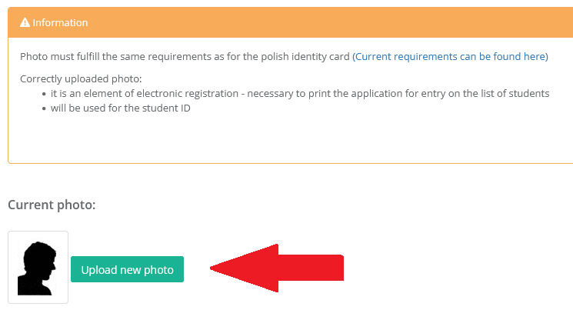
You are almost there! Now it's time to upload a photo that will be find on your student card. Make sure the photo complies requirements.
Do not upload a selfie from your vacations! ☺

Slide 15
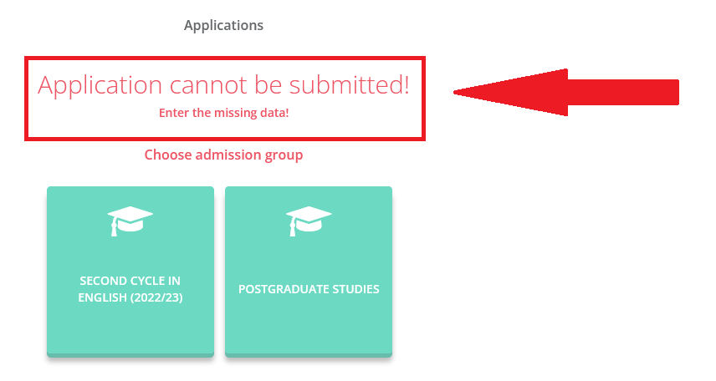
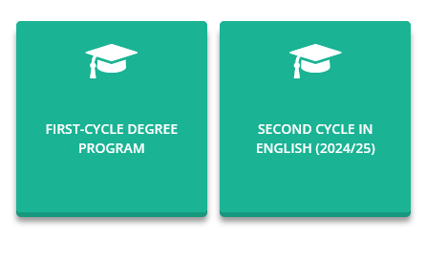
Now it’s time to submit your application:
Don’t wory about this sign. It won’t be shown if you fill up all missing data.

Slide 16
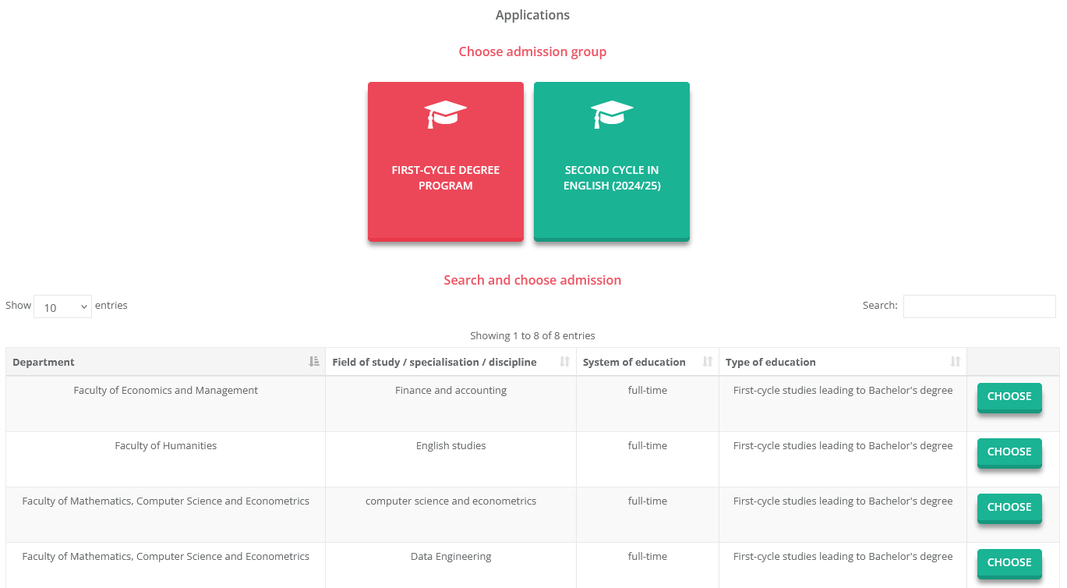
On the next page pick faculty are you intrested in by clicking one of this green buttons:

Slide 17
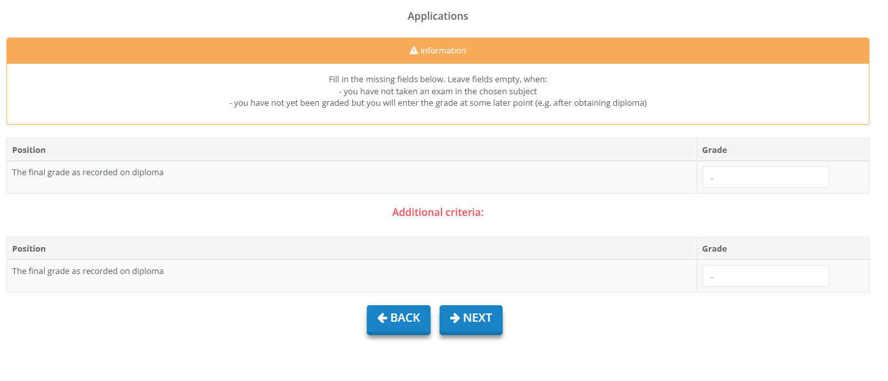
Here you have to fill up final grades from your diploma:

Slide 18
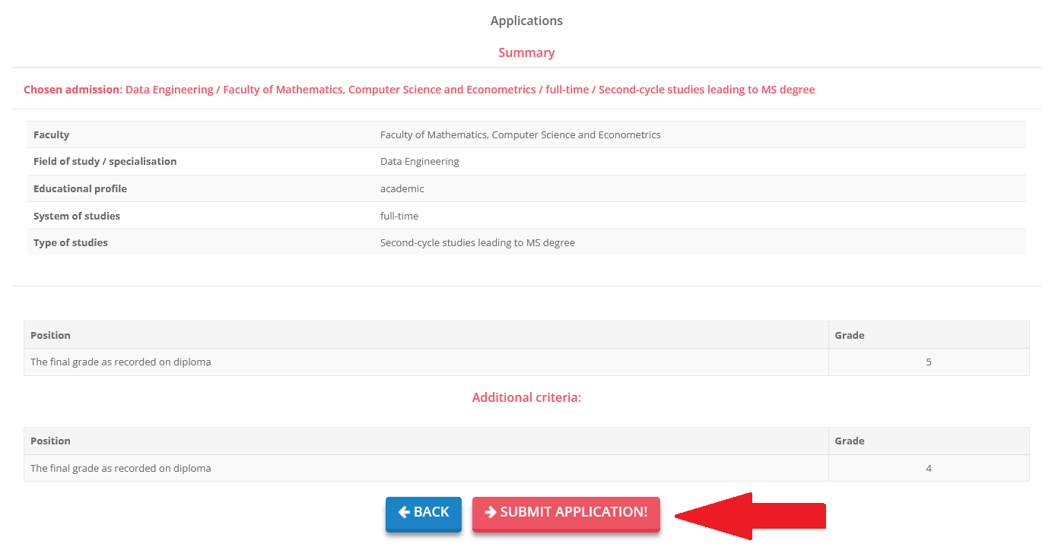
If you choose corectly you can submit your application:

Slide 19
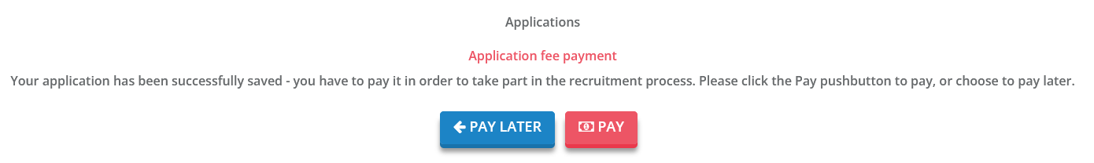
After submitting your application you have to pay the admission fee:

Slide 20
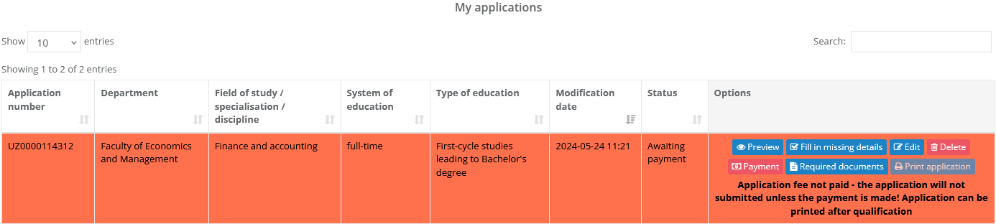
This is how your application presents.
Please note that only paid applications will be accepted!

Slide 21
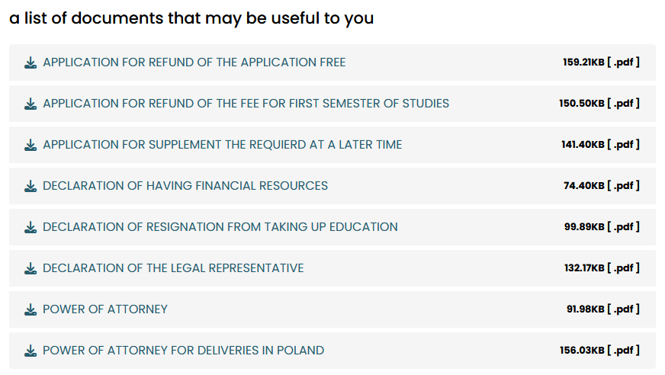
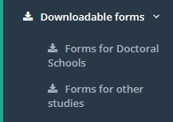
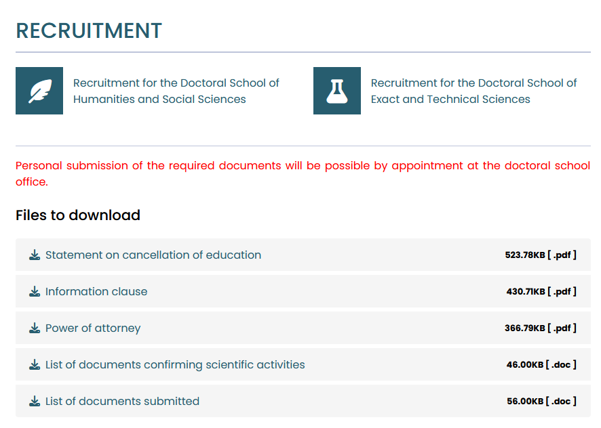
In the next tab you will find links to websites containing the necessary applications or declarations, if necessary.

Slide 22
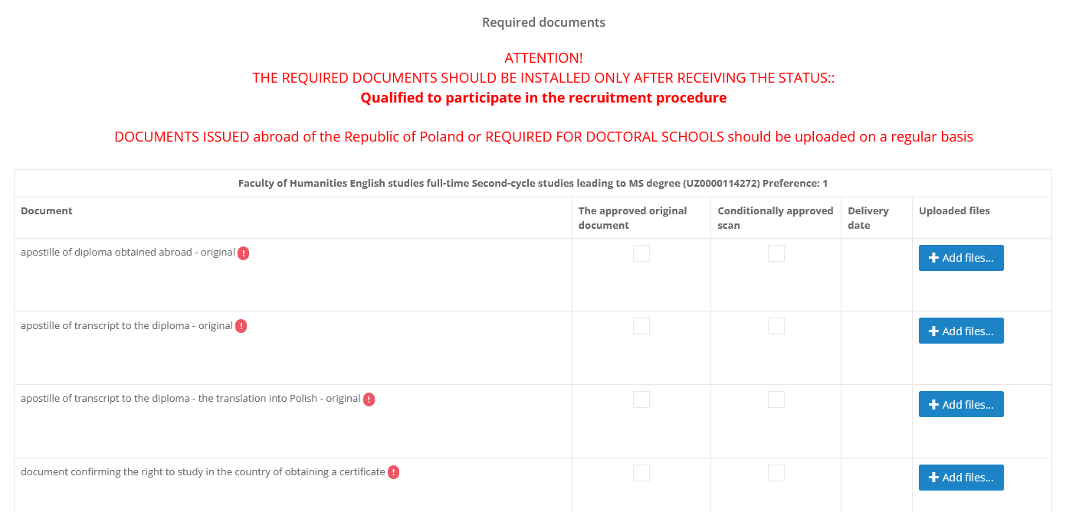
It’s time to add scans of the required documents.
If you have a foreign high school diploma, do it immediately after paying for the application.

Slide 23
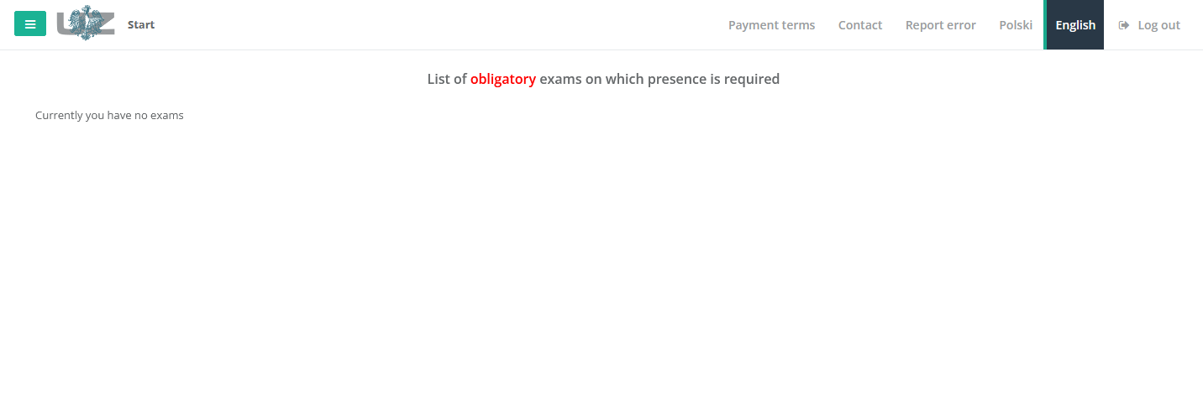
The next tab contains information about exams/interviews that you must pass depending on the chosen faculty.

Slide 24
ATTENTION:
Complete set of required documents, including:
of the original documents. We only accept scans of original documents. We do not accept scans of notarized copies made in the country of issue. – should be uploaded to the „Documents” tab in the recruitment system via your electronic profile.
If all required documents are conditionally accepted, you will receive a message about the payment of the fee for the first semester of study.
Once the tuition fee has been paid, you will receive an "Acceptance letter". With this document, you can start the visa procedure.
There will be a deadline for the final delivery of all original required documents. – should be sent by traditional mail or personally to the following address:
THE RECRUITMENT OFFICE (Rekrutacja UZ)
Al. Wojska Polskiego 69, room number 101R
65-762 Zielona Góra,
POLAND
Color and legible scans

Slide 25
"An application with a signature for admission to studies? It needs to be uploaded, but I can't find it!”
The application for admission to studies will be possible to generate in the „My applications” after receiving the status „Qualified for admission to studies”. Please follow our recruitment calendar and your recruitment profile so you won’t miss the deadline for submission of documents!

Slide 26
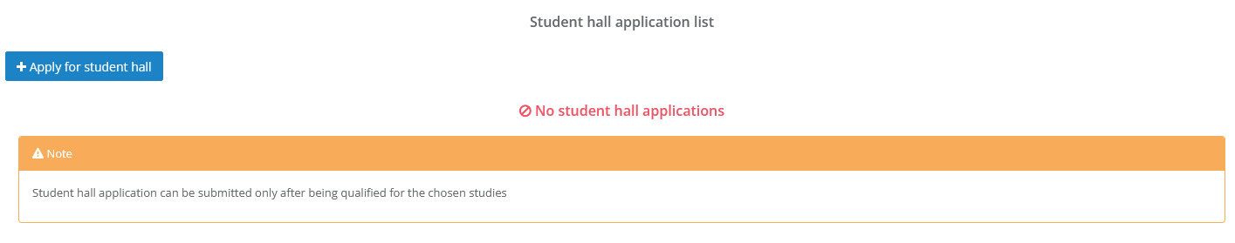
After qualifying for admission, you can submit an application for a dormitory:

Slide 27

If you have more questions feel free to contact us:

